Slide 1
Risk Introduction
Power Sector Resilience Planning Guidebook
The following slides are intended to provide additional background information on how to assess and evaluate risks to the power system. They can serve simply as a reference or can be used in local power sector resilience assessment workshops. For questions or more information on the slides, use the “Ask An Expert” feature on the Resilient Energy Platform website.

Slide 2
What is Risk?
Risk is the potential for loss, damage, or destruction of key resources or power system assets resulting from exposure to a threat. Risk scores are the product of the threat likelihood score and the vulnerability severity score.
Risk Score = Threat Likelihood Score x Vulnerability Severity Score

Slide 3
Assessing the Risk Score
Not all threats directly influence each vulnerability. The first step in assessing risk involves determining which threats and vulnerabilities are linked. Some vulnerabilities may be linked to multiple threats.
The risk scores are then calculated for all linked threats and vulnerabilities.
The scores are often shown in a risk-matrix heat map, as shown here, which highlights the highest-risk vulnerability-threat pairs with qualitative scores. However, this matrix can also show quantitative scores.
Vulnerability Severity Score | High | Medium | Medium-to-high | Medium-to-high | High | High
 | Medium-to-high | Medium | Medium | Medium-to-high | Medium-to-high | High
 | Medium | Low-to-medium | Medium | Medium | Medium-to-high | Medium-to-high
 | Low-to-medium | Low-to-medium | Low-to-medium | Medium | Medium | Medium-to-high
 | Low | Low | Low-to-medium | Low-to-medium | Medium | Medium
 |  | Low | Low-to-medium | Medium | Medium-to-high | High
 |  | Threat Likelihood Score

Slide 4
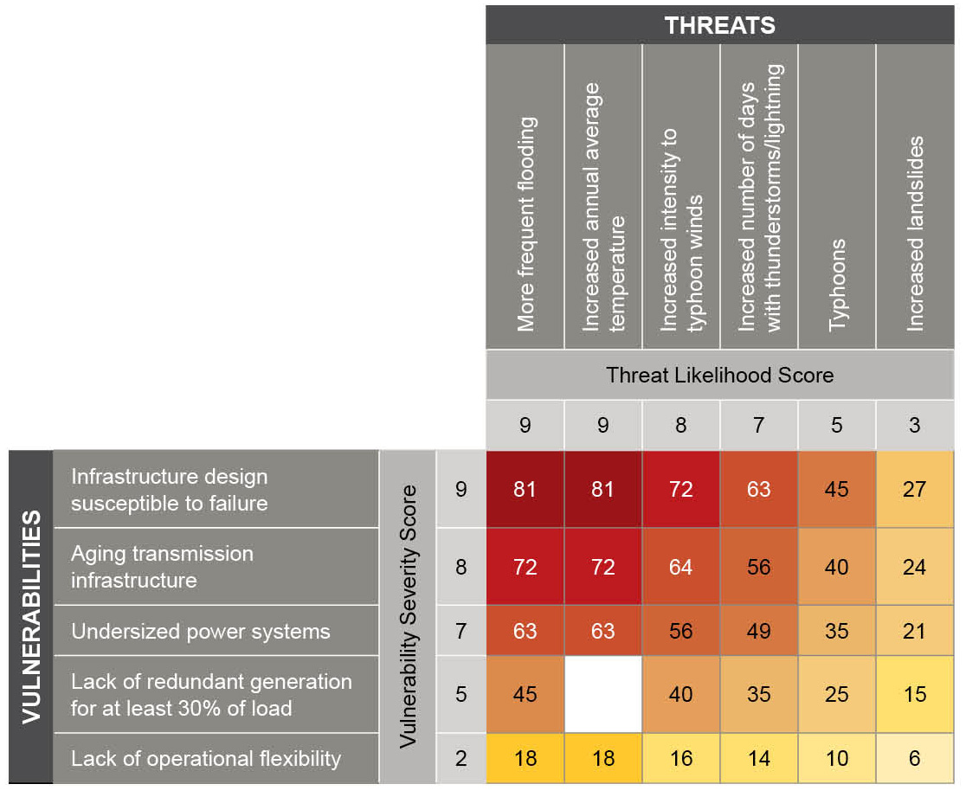
Evaluating Risks
The risk-matrix heat map is helpful for showing the relative importance of different risks.
Displaying in this format facilitates understanding of the interactions between threats and vulnerabilities, identifies potential solutions, and helps prioritize resilience planning efforts.
Hypothetical example of a national resilience planning process risk assessment, based on a risk matrix developed by Anderson et al, 2018.

